Slide 1
Factor Analysis Tutorial
BAMA 509
November 7, 2017

Slide 2
Factor Analysis
We’ll be using factor analysis to:
Identify correlation structure among variables
Link each variable to an underlying factor
Label each factor
Use factor scores to conduct cluster analysis
Conduct crosstabs to describe the clusters
Notes:
We’ll be using a very applied approach to interpretation. The math behind the analysis is slightly more complex than cluster analysis, so here I really want to focus on applying the functions and interpreting the output. You still need some sense of what’s going on in the background, but in the interest of time we’ll take a very practical approach.

Slide 3
Chewing Gum Data
Respondents rated the following statements on a 7-point Likert scale:
I like a gum that gives shiny teeth.
It is important to buy a gum that prevents cavities.
I prefer a gum that freshens breath.
Chewing gum should strengthen gums.
The most important consideration in buying a gum is attractive teeth.
Prevention of tooth decay is not an important benefit offered by a gum.
30 Respndents
Demographics: Gender and Age
6 attitudinal variables
Each of the variables is measured on a scale from 1 to 7
This one is reverse coded!

Slide 4
Are these data appropriate for factor analysis?
library(REdaS)
> bart_spher(gums[,c("V1", "V2", "V3", "V4", "V5", "V6")])
Bartlett's Test of Sphericity
Call: bart_spher(x = gums[, c("V1", "V2", "V3", "V4", "V5", "V6")])
X2 = 111.314
df = 15
p-value < 2.22e-16
> KMOS(gums[,c("V1", "V2", "V3", "V4", "V5", "V6")])
Kaiser-Meyer-Olkin Statistics
Call: KMOS(x = gums[, c("V1", "V2", "V3", "V4", "V5", "V6")])
Measures of Sampling Adequacy (MSA):
V1 V2 V3 V4 V5 V6
0.6206187 0.6972902 0.6787086 0.6367264 0.7687446 0.5612345
KMO-Criterion: 0.6600399
Data that show limited correlation between the variables of interest is generally not appropriate for factor analysis.
Two criteria that are commonly used to evaluate factorability are Kaiser-Meyer-Olkin measures of sampling adequacy (KMO-test) and the Bartlett’s test for sphericity. The overall KMO measure and the Bartlett’s test evaluate the available data all together. Overall KMO values over 0.6, and significant levels in the Bartlett’s test statistic (a chi-square) suggest that there are at least some significant values in an anti-image matrix of partial correlations for the data.
Notes:
Why is low correlation not appropriate for factor analysis? Because factors are used to describe relationships between variables, i.e. group them
Bartlett – see whether the samples come from populations with equal variances
KMO – how well the data will factor, based on the correlation structure between variables

Slide 5
Number of factors
Once we have determined that the data is appropriate for factor analysis, the next step is to determine the number of factors needed to explain the correlations among the variables.
Factors that do not explain even as much variance in the data as an ‘average’ variable are generally omitted from further consideration. These factors will have eigenvalues < 1 in the output.
ev <- eigen(cor(gums[,c("V1", "V2", "V3", "V4", "V5", "V6")]))$values
e <- data.frame(
Eigenvalue = ev,
PropOfVar = ev / length(ev),
CumPropOfVar = cumsum(ev / length(ev)))
> round(e, 4)
Eigenvalue PropOfVar CumPropOfVar
1 2.7312 0.4552 0.4552
2 2.2181 0.3697 0.8249
3 0.4416 0.0736 0.8985
4 0.3413 0.0569 0.9554
5 0.1826 0.0304 0.9858
6 0.0852 0.0142 1.0000
A set of factors that together explain > 70% of the variance in the original data is generally considered acceptable. In our application the total variance explained by the 2 factors is about 82%.
Also, the increase in cumulative % explained variance is small when going from 2 to 3 factors. This is confirmed by the fact that the initial eigenvalue for factor 3 is smaller than 1 (= .44). Therefore, we choose 2 factors.

Slide 6
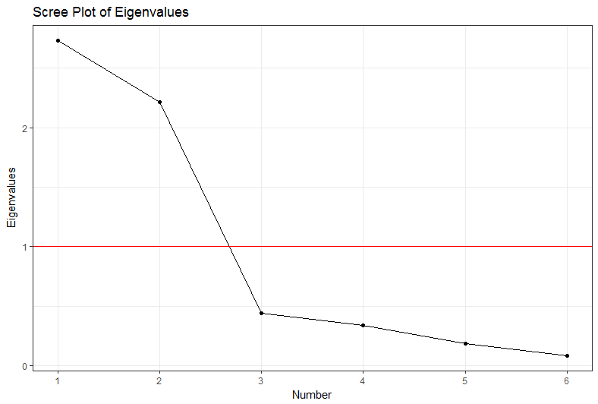
Number of factors
A further criteria that is often used to determine the number of factors is the scree-plot. This is a plot of the eigen-values against the number of factors, in order of extraction. Often an elbow is visible in the curve. Factors up to and including this elbow are then selected for further analysis, if they all have eigen-values above 1
The Scree plot obtained suggests that 2 factors should be extracted. This reflects the eigenvalues listed above showing that the first two factors have eigen-value higher than 1.

Slide 7
Extracting a solution
Once we have determined the number of factors, we extract and rotate them. The factors are rotated to generate a solution where a variable loads as much as possible on only one factor. This optimization allows to better interpret the meaning of the factor and its association with the variables in the data.
We will use the varimax rotation algorithm to rotate a factor solution. The rotated component matrix generated by the procedure will allow us to associate the highest factor loadings, in absolute values, with specific variables to then find a concept and a label for the underlying factors.
We program the rotation procedure to (1) produce the rotated component matrix and sort the factor loadings; (2) generate the loading plot (for two factors).
The final step is to generate the factor scores, a sort of weighted average scores for variables linked to the factor – i.e., an approximation of the score that a respondent would have provided if we were able to ask about the factor directly in a single survey question.

Slide 8
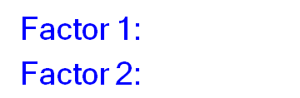
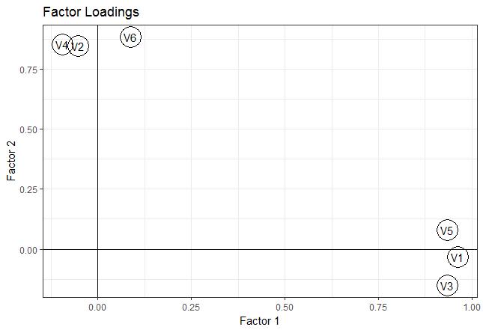
Solution Interpretation
# Create a factor loadings table; Sort based on uniqueness
fl <- cbind.data.frame(
pc$loadings[,],
Uniqueness = pc$uniquenesses)
> round(fl[order(pc$uniquenesses),], 4)
RC1 RC2 Uniqueness
V1 0.9618 -0.0313 0.0741
V3 0.9332 -0.1505 0.1064
V5 0.9335 0.0795 0.1222
V6 0.0877 0.8846 0.2099
V4 -0.0942 0.8546 0.2609
V2 -0.0531 0.8485 0.2773
The rotated factor loadings table shows correlations for each of the 6 variables. For instance, V1 has a high correlation (0.962) with factor 1, and low correlation (-0.031) with factor 2.
The loading plot generated by the factor procedure shows two distinct relationships with the 2 factors.
Prevents tooth decay
Prevents cavities
Strengthens gums
Attractive teeth
Shiny teeth
Freshens breath
Notes:
The two factors are described in similar terms as our clusters

Slide 9
Segmenting Based on Factor Scores
> pc$scores
RC1 RC2
1 1.143442263 -0.30235970
2 -1.164116133 -0.33355156
3 1.275077650 -0.85487286
4 0.283039210 1.10541625
5 -1.414762055 -1.47784848
6 0.962545953 -0.30691756
7 0.386174401 -0.92946239
8 1.314326185 -0.02535258
9 -1.013720900 -0.63921247
10 -1.294148852 1.54533311
11 1.102641284 -0.61319753
12 -1.150922200 -0.30734835
13 1.288271583 -0.82866966
14 0.148988842 1.35740692
15 -1.326348572 -0.91233215
16 0.789822075 -0.33831055
17 0.608638252 -0.61593673
18 1.494934982 -0.29386303
19 -1.026914833 -0.66541567
20 -0.394466651 1.34560335
21 -1.192010691 -0.89125450
22 0.614234778 -0.01676177
23 -0.978198322 -0.27595537
24 -0.006906942 1.88496785
25 0.833064467 -0.23598682
26 -0.188090764 1.60734167
27 0.828974634 -0.32986524
28 -0.677614532 1.06323436
29 0.182192413 2.24121650
30 -1.428147525 -0.95604502
The two factor scores we calculated in the rotation were also added to the data set—labeled RC1 and RC2 here.
Can we use the factor scores?
How?
In this example, the factor scores obtained seem to measure underlying perceptions among respondents in the sample. Therefore, we can use the scores to find segments in the population with similar perceptions.
We can use the factor scores to conduct cluster analysis.
Notes:
Recall: what is a factor score? Like an average score of all the variables related to that factor for each respondent. Negative and positive values come from the factor loadings.

Slide 10
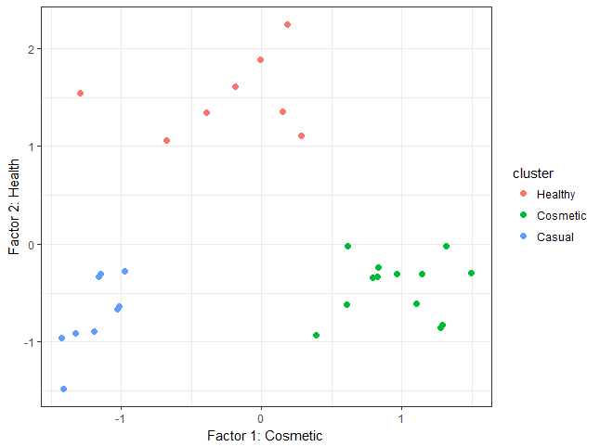
Segmenting with Cluster Analysis
# First, standardize the input variables (z-scores)
z <- scale(pc$scores, center = TRUE, scale = TRUE)
# Since the k-means algorithm starts with a random set of centers, setting the seed helps ensure the results are reproducible
set.seed(1)
# Apply K-means clustering with the selected numbers of centers (e.g. 3)
k <- kmeans(z, centers = 3)
> # Display cluster sizes
> k$size
[1] 8 13 9
> # Cluster means
c("RC1", "RC2"),
function(n) k$centers[, n]*sd(pc$scores[,n]) + mean(pc$scores[,n]))
RC1 RC2
1 -0.2433759 1.5188150
2 0.9724730 -0.4378120
3 -1.1883490 -0.7176626
If factor 1 is about cosmetics and factor 2 about health, then the three segments created can be interpreted as respondents focused on cosmetic issues (cluster no. 2), those focused on therapeutic use (no. 1), and others “uninvolved” (no. 3).
(cosmetic factor)
(health factor)

Slide 11
Describing the Segments: Crosstabs
Cell Contents
|-------------------------|
| N |
| Expected N |
| Chi-square contribution |
|-------------------------|
Total Observations in Table: 30
| gums$gender
gums$cluster | male | female | Row Total |
-------------|-----------|-----------|-----------|
1 | 1 | 7 | 8 |
| 3.467 | 4.533 | |
| 1.755 | 1.342 | |
-------------|-----------|-----------|-----------|
2 | 5 | 8 | 13 |
| 5.633 | 7.367 | |
| 0.071 | 0.054 | |
-------------|-----------|-----------|-----------|
3 | 7 | 2 | 9 |
| 3.900 | 5.100 | |
| 2.464 | 1.884 | |
-------------|-----------|-----------|-----------|
Column Total | 13 | 17 | 30 |
-------------|-----------|-----------|-----------|
Statistics for All Table Factors
Pearson's Chi-squared test
------------------------------------------------------------
Chi^2 = 7.571354 d.f. = 2 p = 0.02269349
Can we describe these segments using demographic data?
Yes! Conduct crosstabs of gender and cluster membership
Null hypothesis (H0): There is no relationship between gender and cluster membership.
We can use the CrossTabs() function from the gmodels package in R
3 cells out of 6 (50%) have expected count less than 5

Slide 12
Factor Analysis Tutorial: Summary
Conduct initial factor analysis to
Determine if the data has the appropriate correlation structure (KMO-test, and Bartlett’s test for sphericity)
Determine number of factors (Eigen Value > 1)
Obtain rotated factor solution (using the determined number of factors from above) to create:
Factor loadings (correlation between attributes and factors) and
Factor scores (inferred rating of the new factors)
Use factor loading to interpret the factors
Mark the highest factor loading, in absolute value, in each row
When applicable, use factor scores to conduct cluster analysis
When applicable, use crosstabs to describe the clusters (segments)

Slide 13
Cluster vs Factor Analysis
 | Cluster Analysis | Factor Analysis
What are we trying to group? | Cases / Subjects / Observations | Features
Purpose | Find a small set of cases representative of data as a whole | Find a small set of features representative of the original set
Objective | Divide data into distinct, homogeneous groups Identify groups in the data to simplify comparisons between observations Identify characteristics of objects which share a group | Explain the homogeneity of the variables Identify underlying factors Identify groupings resulting in one variable representative of many
For more details: https://www.educba.com/cluster-analysis-vs-factor-analysis/

Slide 14
Appendix Dictionary -- Rotation
There are a large number of rotation options for factor analysis (including no rotation).
We in general will use varimax rotation.
With varimax rotation, the factor loading matrix is solved so that most values are near ±1 or 0.
This makes factors much more readily interpretable.
Note: A disadvantage of varimax rotation is that the factor loading matrix, for example, of a three-factor solution will not in general look like the first three columns of the factor loading matrix of the four-factor solution for the same data. With no rotation, they will be identical.

